Slide 1
Chapter 1: Getting Started with Struts2

Slide 2
Learning Objectives
Introduction
Struts Framework Architecture
First Application using Struts Framework
web.xml and Struts configuration file (struts.xml)

Slide 3
Struts2 - Overview
Apache Struts is a free, open-source, MVC framework for creating elegant, modern Java web applications. It favors convention over configuration, is extensible using a plugin architecture, and ships with plugins to support REST, AJAX and JSON.
Web applications based on JavaServer Pages sometimes commingle database code, page design code, and control flow code. In practice, we find that unless these concerns are separated, larger applications become difficult to maintain.
The Struts framework is designed to help developers create web applications that utilize a MVC architecture.
The framework provides three key components:
A “request” handler provided by the application developer that is mapped to a standard URI.
A “response” handler that transfers control to another resource which completes the response.
A tag library that helps developers create interactive form-based applications with server pages. The framework’s architecture and tags are buzzword compliant. Struts works well with conventional REST applications and with technologies like SOAP and AJAX.
The Apache Struts Project offered two major versions of the Struts framework. Currently only the Struts 2 version is being maintained.

Slide 4
Struts Application Architecture

Slide 5

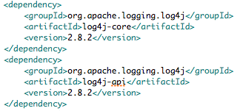
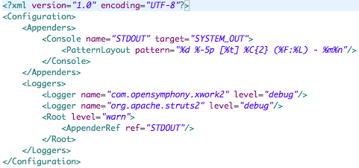
Struts: Getting Started - First Application
Create a new Maven project using the archetype using maven-archetype-webapp.
Add struts2 maven dependencies:
Add log4j maven dependencies:
Add log4j.xml:

Slide 6
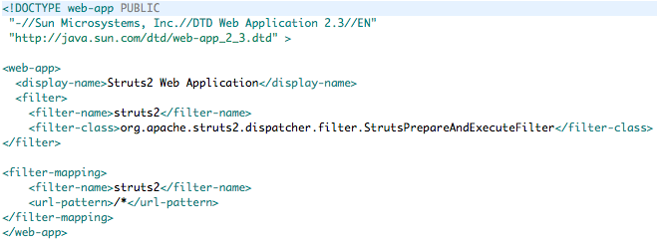
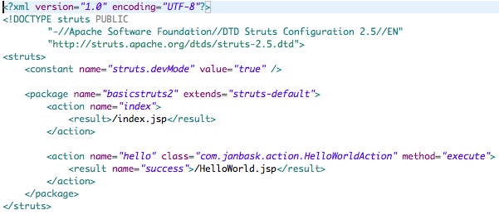
Struts: Getting Started - First Application…
Add Struts 2 Servlet Filter in web.xml:
Create struts.xml:

Slide 7
Struts Application Anatomy: Directory Structure

Slide 8
Struts2 - Features
POJO Forms and POJO Actions − Struts2 has done away with the Action Forms that were an integral part of the Struts framework. With Struts2, you can use any POJO to receive the form input. Similarly, you can now see any POJO as an Action class.
Tag Support − Struts2 has improved the form tags and the new tags which allow the developers to write less code.
AJAX Support − Struts2 has recognized the take over by Web2.0 technologies, and has integrated AJAX support into the product by creating AJAX tags, this function is very similar to the standard Struts2 tags.
Easy Integration − Integration with other frameworks like Spring, Tiles and SiteMesh is now easier with a variety of integration available with Struts2.
Template Support − Support for generating views using templates.

Slide 9
Struts2 – Features…
Plugin Support − The core Struts2 behavior can be enhanced and augmented by the use of plugins. A number of plugins are available for Struts2.Profiling − Struts2 offers integrated profiling to debug and profile the application. In addition to this, Struts also offers integrated debugging with the help of built in debugging tools.
Easy to Modify Tags − Tag markups in Struts2 can be tweaked using Freemarker templates. This does not require JSP or java knowledge. Basic HTML, XML and CSS knowledge is enough to modify the tags.
Promote Less configuration − Struts2 promotes less configuration with the help of using default values for various settings. You don't have to configure something unless it deviates from the default settings set by Struts2.View Technologies − Struts2 has a great support for multiple view options (JSP, Freemarker, Velocity and XSLT)

Slide 10
Struts2 – Architecture Explained
From a high level, Struts2 is a pull-MVC (or MVC2) framework. The Model-View-Controller pattern in Struts2 is implemented with the following five core components:
Actions
Interceptors
Value Stack / OGNL
Results / Result types
View technologies
Struts 2 is slightly different from a traditional MVC framework, where the action takes the role of the model rather than the controller, although there is some overlap.

Slide 11
Struts2 – Architecture Explained
The diagram depicts the Model, View and Controller to the Struts2 high level architecture.
The controller is implemented with a Struts2 dispatch servlet filter as well as interceptors, this model is implemented with actions, and the view is a combination of result types and results.
The value stack and OGNL provides common thread, linking and enabling integration between the other components.
Apart from the above components, there will be a lot of information that relates to configuration. Configuration for the web application, as well as configuration for actions, interceptors, results, etc.
This is the architectural overview of the Struts 2 MVC pattern.
We will go through each component in more detail in the subsequent chapters.

Slide 12
Struts2 Request/Response Life Cycle
Based on the diagram, you can understand the work flow through user's request life cycle in Struts 2 as follows:
User sends a request to the server for requesting for some resource (i.e. pages).
The Filter Dispatcher looks at the request and then determines the appropriate Action.
Configured interceptor functionalities applies such as validation, file upload etc.
Selected action is performed based on the requested operation.
Again, configured interceptors are applied to do any post-processing if required.
Finally, the result is prepared by the view and returns the result to the user.

Slide 13
What are we learning in Next Chapter ?
You will learn about Basic Struts Mechanism
We will learn about:
Struts Flow of Execution
Introducing Struts Elements
Struts View (JSP)
Action Servelet
RequestProcessor
FormBean(ActionForm)
Built-in Action classes

Slide 14
Thank You !

